Slide 1
Introduction
Our Solution for the Mentioned Problem Statement Comprised of Different Modules such as Alert & Notification Module, Real Time Data Collection Module from Authenticated Source , Precaution Module to Define and Broadcast Protocol to Disaster Affected Areas , Social Media Message Circulation (SMMC) Module.
IENS (Indian Early Notification System) has been designed by our team to Get & Fetch Notification System as soon as Disaster Stuck channelize Related Information via Different Social Media Official Platforms .

Slide 2
Description
Our designed product( IENS )works to guard, open out awareness, and to protect the citizens of country from uncertain crisis situations .
Our system keeps the track of all possible disastrous situations which may occur.
And Maps that Real Time Monitoring Emergency System Services Sync with IENS Mobile App Server.
It disseminate and notify information of alert to wider audiences specially at high risks through social media platforms ,according to precaution modules .
And also makes fastest digital interaction with public and get a better sense of what is actually happening on ground during crisis .
Then Communicates with response teams thus gives Quick Help Providence by Acknowledging the Government and response teams based On Impact Severity.

Slide 3
WORK FLOW:
Step1: Mapping Real Time Monitoring Emergency System Services using purchased Disaster API Sync with IENS Mobile App Server.
Step2: Notification or Alert System gets Activated on the occurrence of Abnormal readings in the Data fetched from Disaster API
Step3: Detect the affected Area by Showing Various Nearby Hospitals with Current Occupancy Status.
Step4:Alert Message Broadcasting to the People in the Affected Areas for relocation of People by acknowledging it in to different official accounts of Government through Social Media
Step5:Arrangement of First Aid Services by Near by Hospitals and Quick Help Providence by Acknowledging the State Government based On Impact Severity

Slide 4
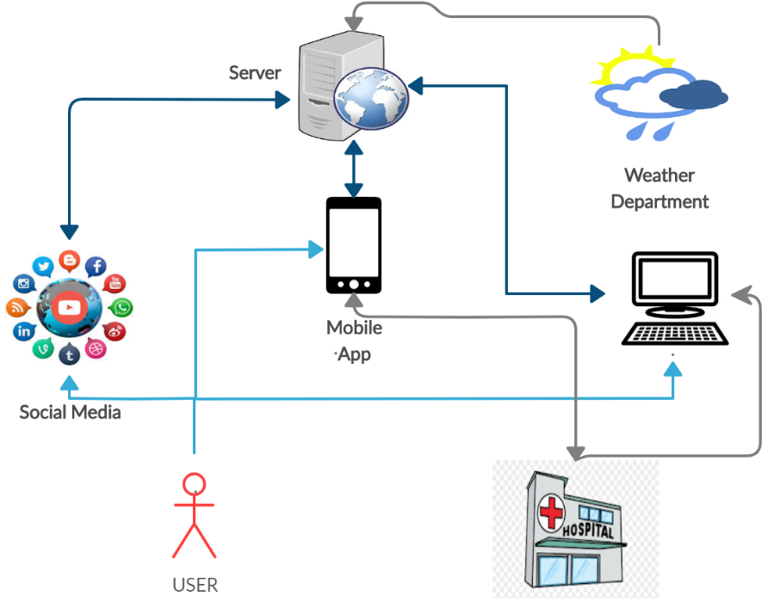
Working
This is how the application will work.

Slide 5
Technical resources
We are using Firebase No Squeal Database to store system data just like big JSON object ,Also to add information to Users s Node to make our system more interactive.
Our system use Spa based on angular JS Framework to enhance more user connectivity with (IENS) app.
We are using Google authentication gateway for user verification.
To enhance user communication in emergency situation we are using TAWK API for chat bot.
For developing personalize app we used Cordova.
IENS will work with several Disaster APIs which are needed to purchase.
Our product design uses Module View Controller Architecture.

Slide 6
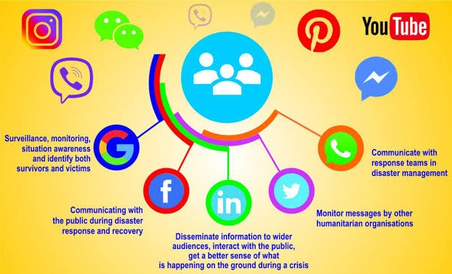
social media resource to spread awarness

Slide 7
Advantages
.
Area wise Emergency alert msg
Providing social media awareness
First aid / Precautions steps
Show nearest Healthcare

Slide 8
Conclusion
Setting of the communication between victims & survivors during disaster. It will solve the over stretched problem of health care centers. Using social media it shows actual crises of situation and efficiently deals with it.

